Slide 1
Publicis Sapient Logo

Slide 2
Variables, Conditional Statements, Looping Statements.
Suvarchala Gatla

Slide 3
Variables
In shell scripting, variables are used to store data, and they provide a way to give names to data values for later use in the script.
Shell variables can hold different types of data, and their names are case-sensitive.
Syntax:
Variable name=<variable value>

Slide 4
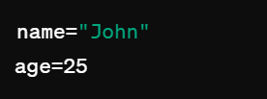

Types of variables
Local Variables:
Local variables are defined within a script or a function and are accessible only in that scope.
For example:
Environment Variables:
Environment variables are accessible to all processes and scripts running in the current environment
Environment variables are only created once, after which they can be used by any user.
For example:

Slide 5
Shell Variables:
Variables that are set by shell itself and help shell to work with functions correctly. It contains both, which means it has both, some variables are Environment variable, and some are Local Variables
For example:
`$PWD` = Stores working directory
`$HOME` = Stores user’s home directory

Slide 6
Conditional Statements
conditional statements are used to make decisions in the script based on certain conditions.
There are total 3 conditional statements which can be used in bash programming
if statement
if-else statement
case statement

Slide 7
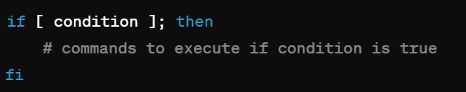
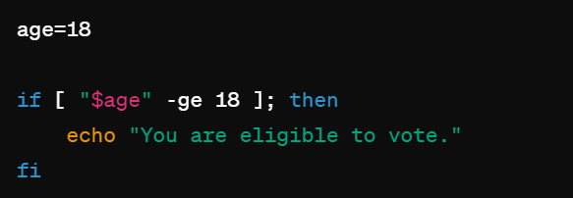

If statement
The if statement allows you to execute a block of code if the condition is true
Example:
Syntax:
Output:

Slide 8
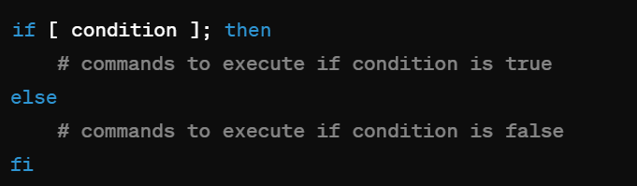
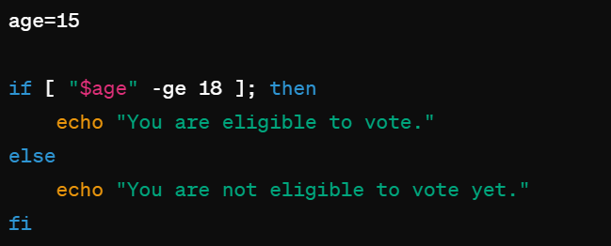
If-else statement
If specified condition is not true in if part then else part will be execute.
Syntax:
Example:
Output:

Slide 9
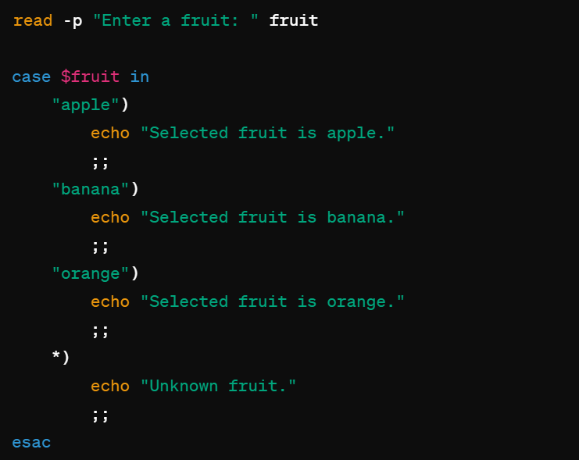
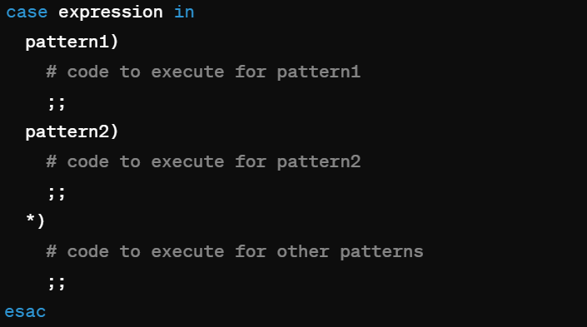

Case Statement:
The case statement allows you to match a value against multiple patterns.
Example:
Syntax:
Output:

Slide 10
Looping Statements
Looping statements in programming are used to execute a block of code repeatedly until a certain condition is met.
There are total 3 looping statements that can be used in bash programming
For loop
While loop
Until loop
Do while

Slide 11
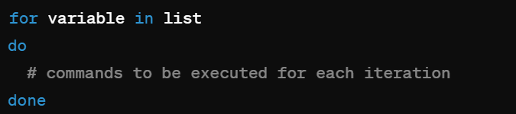
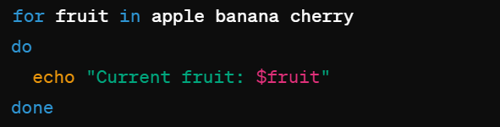
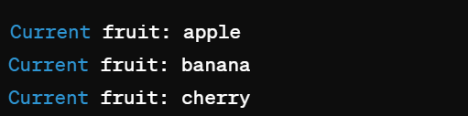
For Loop
Executes a block of code for each item in a specified list
Syntax:
Example:
Output:

Slide 12
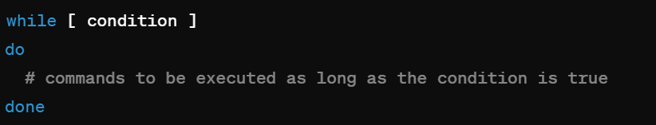
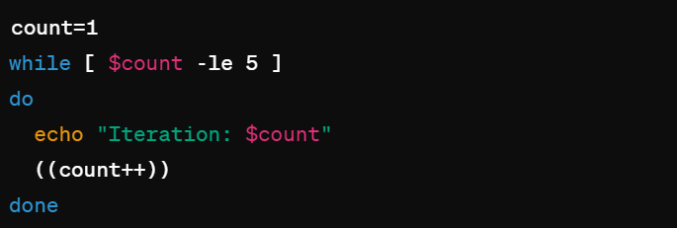
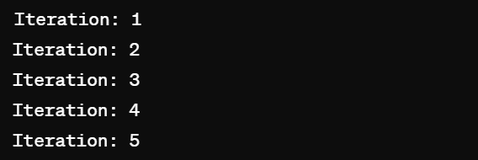
While Loop
Repeatedly executes a block of code as long as a specified condition is true.
Syntax:
Example:
Output:

Slide 13
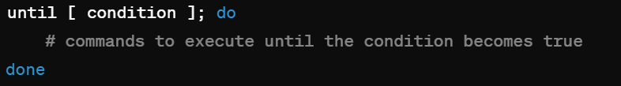
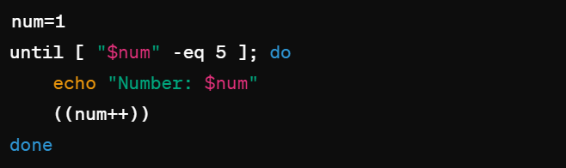
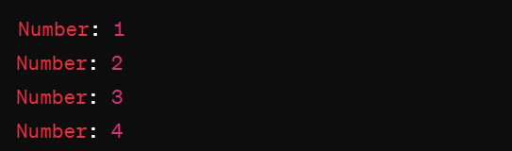
Until Loop
Repeatedly executes a block of code until a specified condition becomes true.
Syntax:
Example:
Output:

Slide 14
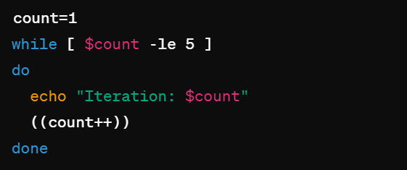
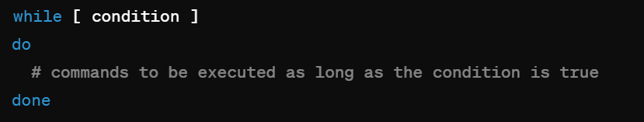
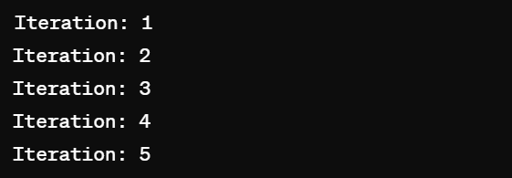
Do-While Loop
Similar to a while loop but ensures that the block of code is executed at least once before checking the condition
Syntax:
Example:
Output:

Slide 15
Thank You

